Slide 1
Relay Instructions
© 2014 John Sefcovic.

Slide 2
Relay Instructions
Relay ladder logic is a SYMBOLIC LANGUAGE constructed as a ladder diagram.
The elements of the ladder rungs are representations of NORMALLY OPEN or CLOSED RELAY CONTACTS as inputs, and outputs as COILS.
The establishing of a complete left to right PATH of TRUE input conditions, will cause a TRUE output action to occur.

Slide 3
Relay Instructions
A PLC program consists of rungs of logic that reads input conditions to cause output actions.
Each rung of logic is comprised of conditional inputs that are Examined for a TRUE condition.
If a true rung exists, then a TRUE output action occurs.
ACTION
CONDITIONAL INPUTS
OUTPUTS
The continuity of the Conditional Inputs will determine the Action Output.

Slide 4
Relay Instructions
Studio 5000
PROGRAM INPUT INSTRUCTIONS
-] [- EXAMINE INPUT CLOSED - XIC
-] / [- EXAMINE INPUT OPENED - XIO
The instruction symbol in the Ladder Logic Program reflects the status, OPEN or CLOSED, of the Input Field Device.
A program interprets the status of an address referenced to an instruction for a true condition.
PROGRAM OUTPUT INSTRUCTION
-( )- ENERGIZE OUTPUT
The output instruction referenced to the address will turn on when the rung condition is true.

Slide 5
Relay Instructions
OUTPUT ENERGIZE (OTE)
Studio 5000
TAG
SOURCE:TYPE:WORD.BIT
-( )-
The Output Energize (OTE) instruction will be set to a LOGIC '1' when there is a complete left to right path of TRUE input instructions. Else, a logic '0' is stored in memory.
That is, the output field device is turned on when a LOGIC '1' is written to output interface.

Slide 6
Relay Instructions
EXAMINE ON
EXAMINE INPUT CLOSED (XIC)
Studio 5000
TAG
SOURCE:TYPE:WORD.BIT
-] [-
The Examine Input Closed (XIC) instruction compares the logic status of the memory bit addressed by the instruction. If the status is a LOGIC '1' then the instruction is TRUE.
That is, if the electrical contacts of the field device wired to input interface are closed (MADE), a LOGIC '1' is read into memory and the examined memory state is true for the instruction type.

Slide 7
Relay Instructions
EXAMINE OFF
EXAMINE INPUT OPENED (XIO)
Studio 5000
TAG
SOURCE:TYPE:WORD.BIT
-] / [-
The Examine Input Opened (XIO) instruction compares the logic status of the memory bit addressed by the instruction. If the status is a LOGIC ‘0' then the instruction is TRUE.
That is, if the electrical contacts of the field device wired to input interface are opened (BREAK), a LOGIC ‘0' is read into memory and the examined memory state is true for the instruction type.

Slide 8
Relay Instructions
XIC - XIO STATEMENTS
For these instruction statements to be TRUE:
EXAMINE INPUT CLOSED
-] [- = VOLTAGE = ON = LOGIC '1' = SET
EXAMINE INPUT OPEN
-] \ [- = NO VOLTAGE = OFF = LOGIC '0' = RESET

Slide 9
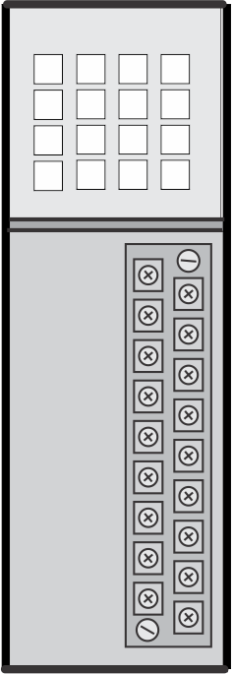
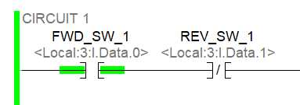

Relay Instructions
The instruction type identifies the state of the Field Input wired to the module for a TRUE condition for that instruction type.
When the switch is in a MADE condition, the Examine Input Closed is TRUE.

Slide 10
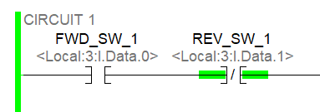

Relay Instructions
The instruction type identifies the state of the Field Input wired to the module for a TRUE condition for that instruction type.
When the switch is in a BREAK condition, the Examine Input Opened is TRUE.

Slide 11
Relay Instructions
PROGRAM INPUT INSTRUCTIONS
-] [- EXAMINE INPUT CLOSED is also called EXAMINE ON.
A Closed contact provides a Voltage signal or On.
-] / [- EXAMINE INPUT OPENED is also called EXAMINE OFF.
An Opened contact provides No Voltage signal or Off.

